Slide 1
Introduction to Monte Carlo Simulation in Finance
Simulating Interest Rates Derivatives Profiles for Counterparty Credit Risk Management
March 17, 2026

Slide 2
Table of contents
Section 1 Counterparty Credit Risk - Introduction
Section 2 Monte Carlo Simulations
Section 3 Modelling Counterparty Credit Risk
Section 4 Backward Induction and American Monte-Carlo Methods

Slide 3
Section 1
Counterparty Credit Risk - Introduction

Slide 4



Counterparty Credit Risk - Introduction
UBS, and other IBs, trade derivatives with various counterparties worldwide;
Typical scenario:
Company XYZ issues $1bi of 15y bonds at fixed rate;
Company XYZ enters into a swap with UBS to transform its fixed rate liability into a floating one, ie, UBS pays fixed rate to XYZ Co. vs receiving floating for 15y in $1bi;
To hedge market risk, UBS enters into offsetting transactions with another Bank.
Company XYZ
Another bank
IRS
Hedging
BANKRUPT
What can go wrong?
Notes:
What can go wrong? The company will default and it will not able to fulfil its payment obligation with UBS. UBS will not receive floating payments from the company but will still be required to pay floating rate to the other bank.

Slide 5
Counterparty Credit Risk - Introduction
Expected loss – simple example
Example:
$100mio 5y loan to a company
Company has no tangible assets
Probability of default over next 5y is 5%
Expected Loss = EAD x PD x LGD
EAD: Exposure at Default
PD: Probability of Default
LGD: Loss Given Default
- What is the EAD?
For a corporate loan, it is easy to determine the EAD (Exposure at Default). But how can we do it for a portfolio of derivatives?

Slide 6
Counterparty Credit Risk - Introduction
Counterparty credit risk
Counterparty credit risk is a risk that a counterparty will not be able to meet its obligations (payments). It is different from the credit risk of bonds and loans.
The loss amount is not known until the time of bunkruptcy
The risk is typically bilateral, both parties take the risk.
Instruments generating counterparty risk:
OTC Derivatives
Financing transactions
forwards
swaps
CDS
European/American/Asian Options
repo
reverse repo
security lending
In financial institutions this risk impacts in particular two areas:
pricing and capital requirements.

Slide 7







Counterparty Credit Risk - Introduction
Credit exposure
We have a derivative X having value at time t.
If the counterparty defaults at time . Our loss is:
$V_{X}(t)$
$$0$$
$$V_{X}(τ)$$
$$V_{X}(τ)$$
Credit exposure at time t is the replacement value of the contract if it is positive and zero otherwise.
$$E_{X}(t)=max(V_{X}(t),0)$$
$$V_{X}(t)$$
We don’t know the future value of , the exposure is random!
Notes:
Counterpaty credit risk is only present when one counterparty has an exposure to the other.

Slide 8
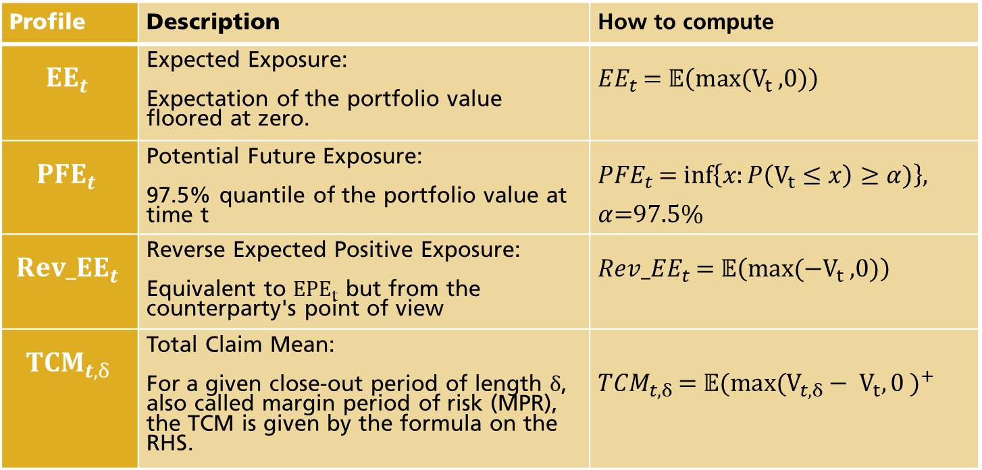
Counterparty Credit Risk - Introduction
Profiles’ definitions
Profile | Description | How to compute
$${EE}_{t}$$ | Expected Exposure: Expectation of the portfolio value floored at zero. | ${EE}_{t}$ = $𝔼\left(max⁡(V_{t} \text{,0)}\right)$
$${PFE}_{t}$$ | Potential Future Exposure: 97.5% quantile of the portfolio value at time t | ${PFE}_{t}$ = $inf\left\{x:P\left(V_{t}≤x\right)≥α)\right\}$, $α$=97.5%
$${Rev_EE}_{t}$$ | Reverse Expected Positive Exposure: Equivalent to ${EPE}_{t}$ but from the counterparty's point of view | ${Rev_EE}_{t}$ = $𝔼\left(max⁡(−V_{t} \text{,0)}\right)$
$${TCM}_{t,δ}$$ | Total Claim Mean: For a given close-out period of length $δ$, also called margin period of risk (MPR), the TCM is given by the formula on the RHS. | ${TCM}_{t, δ}$ = ${𝔼\text{(}\text{max}\text{(}V_{t, δ}− V_{t},0 )}^{+}$

Slide 9
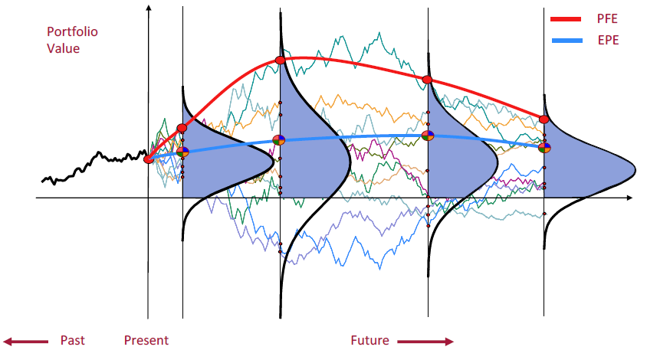
Modelling Counterparty Credit Risk
We can simulate the evolution of the portfolio value over time
Potential Future Exposure (PFE): 97.5% quantile
Expected Positive Exposure (EPE): Average with values floored at 0

Slide 10

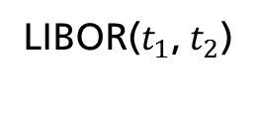

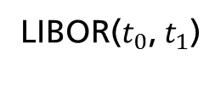


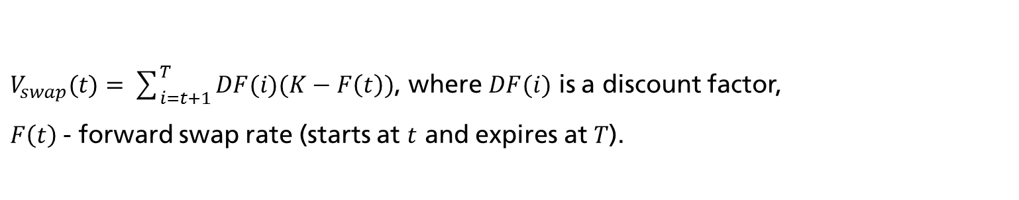
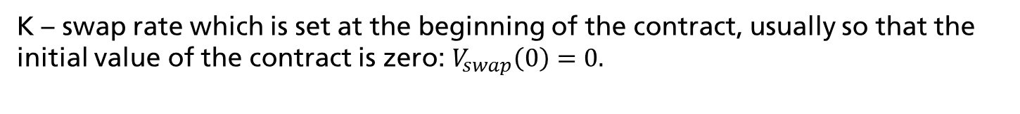


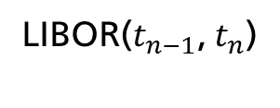
Counterparty Credit Risk - Introduction
Example (interest-rate swap)
Interest Rate Swap (IRS) is a contract, in which two counterparties to agree to exchange future interest payments.
K%
K%
K%
$$…$$
$$t_{0}$$
$$t_{1}$$
$$t_{2}$$
$$…$$
$$t_{n}=T$$
LIBOR($t_{0}$, $t_{1}$)
LIBOR($t_{1}$, $t_{2}$)
LIBOR($t_{n−1}$, $t_{n}$)
K – swap rate which is set at the beginning of the contract, usually so that the initial value of the contract is zero: $V_{swap}\left(0\right)=0.$
$V_{swap}(t)=\sum_{i=t+1}^{T}{DF(i)(K−F\left(t\right)})$, where $DF(i)$ is a discount factor,
$F\left(t\right)$- forward swap rate (starts at $t$ and expires at $T$).
Swaption is an option that gives its holder right to enter into a swap.

Slide 11

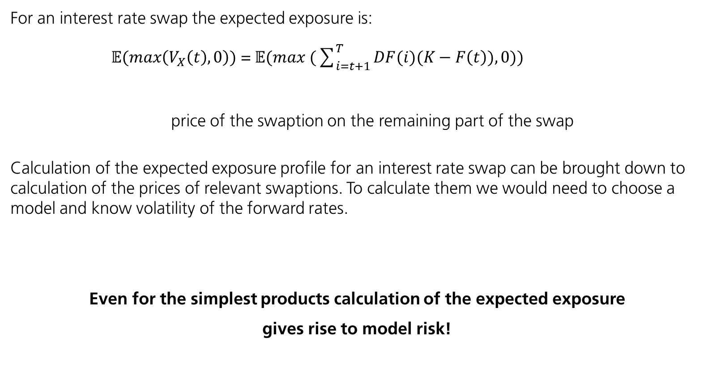
Counterparty Credit Risk - Introduction
Example (interest-rate swap) – cnt’d
For an interest rate swap the expected exposure is:
$𝔼(max\left(V_{X}\left(t\right),0\right))$ =$𝔼(max (\sum_{i=t+1}^{T}{DF(i})(K−F\left(t\right)),0))$
price of the swaption on the remaining part of the swap
Calculation of the expected exposure profile for an interest rate swap can be brought down to calculation of the prices of relevant swaptions. To calculate them we would need to choose a model and know volatility of the forward rates.
Even for the simplest products calculation of the expected exposure
gives rise to model risk!

Slide 12
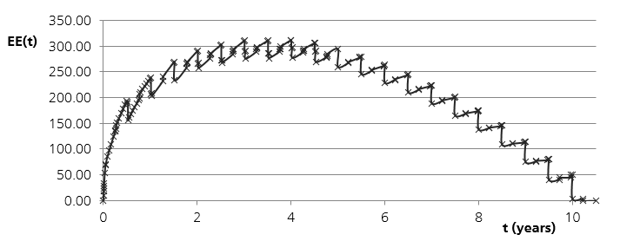
Counterparty Credit Risk - Introduction
Example exposure profile of an at-the-money interest-rate swap
For an at-the-money 10Y swap, where we receive fixed payments the EE profile looks as follows:
The shape of the profile is the results of combination of two effects :
Increasing uncertainty regarding the future cashflows,
Number of future cashflows, decreasing in time.

Slide 13
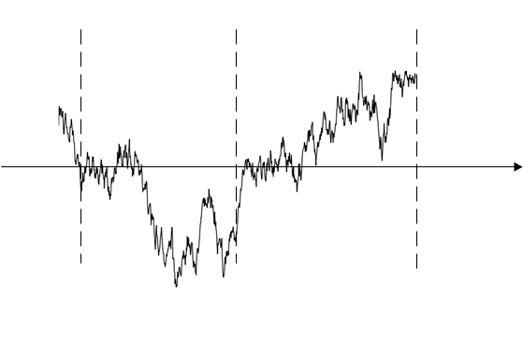
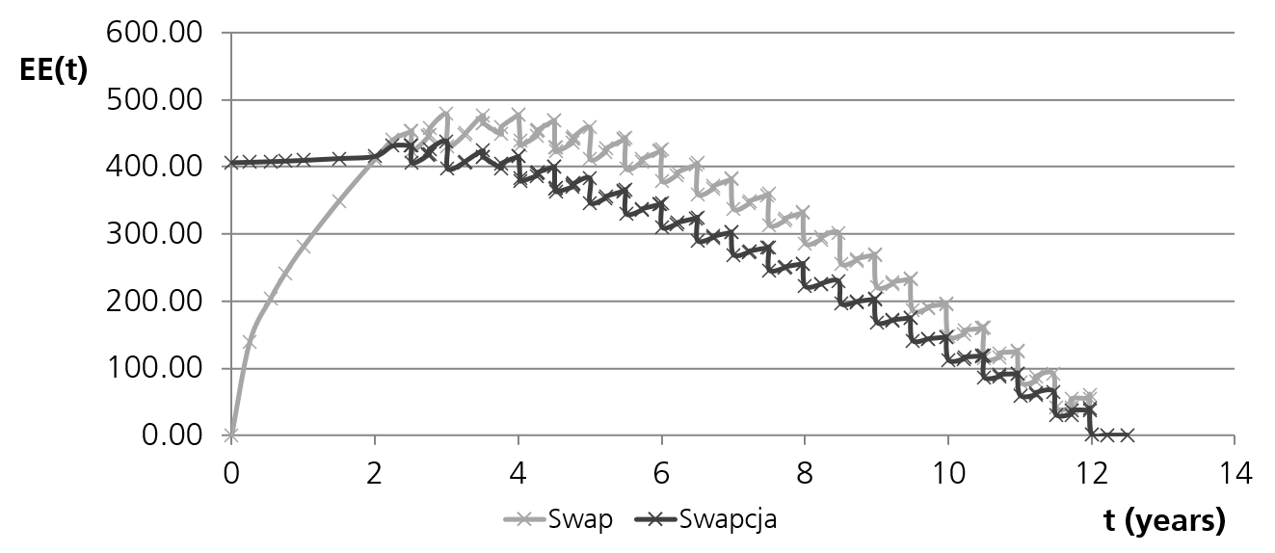
Counterparty Credit Risk - Introduction
Example expected exposure profile of an at-the-money interest-rate swaption
Exposure profile of a 2Yx10Y swaption
and the underlying forward swap:
swap value
time
t
option expiry
0
Until the expiry of the option its value is at least the intrinsic value.
After the expiry in some of the scenarios the option will not be exercised.

Slide 14
Section 2
Monte Carlo Simulations

Slide 15

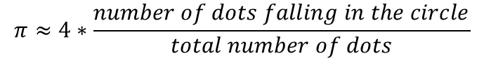



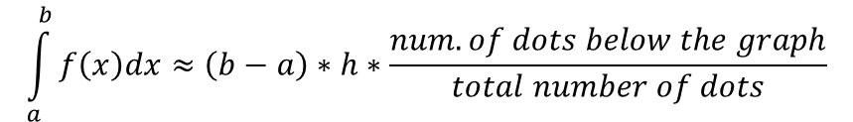

Monte Carlo Simulations
Monte Carlo methods - introduction
Monte Carlo methods – a class of algorithms that rely on repeated random sampling to obtain numerical results.
Some famous examples:
approximation of $π$
approximation of the value of an integral
$$h$$
$$f(x)$$
$$a$$
$$b$$
$$π≈4∗\frac{number of dots falling in the circle}{total number of dots}$$
$$\int_{a}^{b}{f\left(x\right)dx}≈\left(b−a\right)∗h∗\frac{num. of dots below the graph}{total number of dots}$$

Slide 16
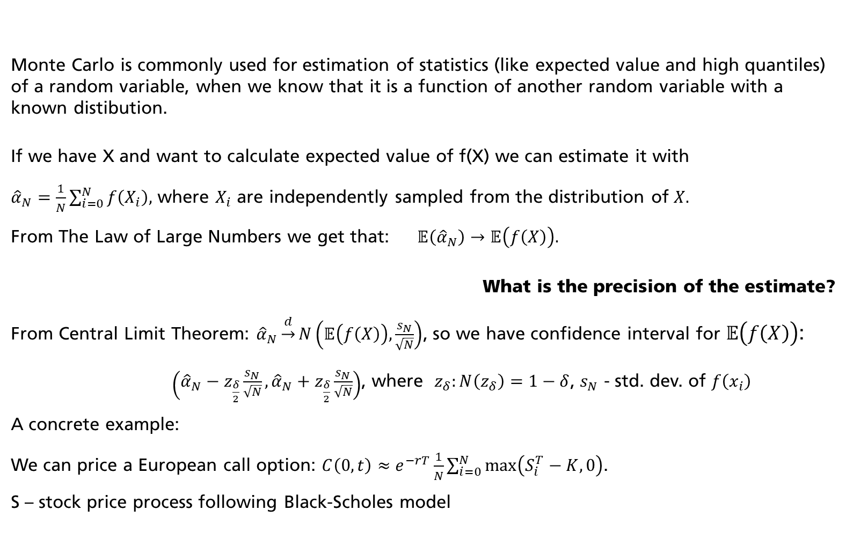
Monte Carlo Simulations
Monte Carlo is commonly used for estimation of statistics (like expected value and high quantiles) of a random variable, when we know that it is a function of another random variable with a known distibution.
If we have X and want to calculate expected value of f(X) we can estimate it with
${\hat{α}}_{N}=\frac{1}{N}\sum_{i=0}^{N}{f\left(X_{i}\right),}$ where $X_{i}$ are independently sampled from the distribution of $X.$
From The Law of Large Numbers we get that: $𝔼\left({\hat{α}}_{N}\right)→𝔼\left(f\left(X\right)\right).$
What is the precision of the estimate?
From Central Limit Theorem: ${\hat{α}}_{N}\underset{→}{d}N\left(𝔼\left(f\left(X\right)\right),\frac{s_{N}}{\sqrt{N}}\right)$, so we have confidence interval for $𝔼\left(f\left(X\right)\right)$:
$\left({\hat{α}}_{N}−z_{\frac{δ}{2}}\frac{s_{N}}{\sqrt{N}},{\hat{α}}_{N}+z_{\frac{δ}{2}}\frac{s_{N}}{\sqrt{N}}\right)$, where $z_{δ}:N\left(z_{δ}\right)=1−δ$, $s_{N}$ - std. dev. of $f\left(x_{i}\right)$
A concrete example:
We can price a European call option: $C\left(0,t\right)≈e^{−rT}\frac{1}{N}\sum_{i=0}^{N}{\max\left(S_{i}^{T}−K,0\right)}$.
S – stock price process following Black-Scholes model
Monte Carlo methods – introduction cnt’d

Slide 17


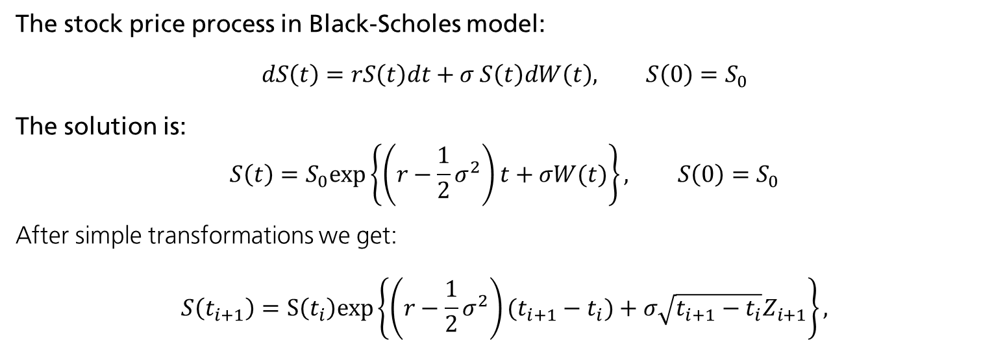





Monte Carlo Simulations
Stochastic process path generation example
Let $t_{0}=0<t_{1}< …<t_{n}=T,$
$$…$$
$$…$$
$$t_{n}=T$$
$$t_{0}$$
$$t_{1}$$
$$t_{2}$$
The stock price process in Black-Scholes model:
$$dS\left(t\right)=rS\left(t\right)dt+σ S\left(t\right)dW\left(t\right), S\left(0\right)=S_{0}$$
The solution is:
$$S\left(t\right)=S_{0}exp\left\{\left(r−\frac{1}{2}σ^{2}\right)t+σW(t)\right\}⁡, S\left(0\right)=S_{0}$$
After simple transformations we get:
$$S\left(t_{i+1}\right)=S\left(t_{i}\right)exp\left\{\left(r−\frac{1}{2}σ^{2}\right)(t_{i+1}−t_{i})+σ\sqrt{t_{i+1}−t_{i}}Z_{i+1}\right\}⁡,$$

Slide 18

Modelling Counterparty Credit Risk
Stochastic process path generation – general recipe
How do we discretize and simulate a stochastic process in general?
$$dX\left(t\right)=a(X\left(t\right))dt+b(X\left(t\right)) dW\left(t\right), X\left(0\right)=X_{0}$$
The Euler discretization scheme:
$$\hat{X}\left(t_{i+1}\right)=\hat{X}\left(t_{i}\right)+a\left(\hat{X}\left(t_{i}\right)\right)\left(t_{i+1}−t_{i}\right)+b\left(\hat{X}\left(t_{i}\right)\right)\sqrt{\left(t_{i+1}−t_{i}\right)}Z_{i+1},$$
$$i=0,…,n−1, Z_{i} −i.i.d. N(0,1)$$

Slide 19
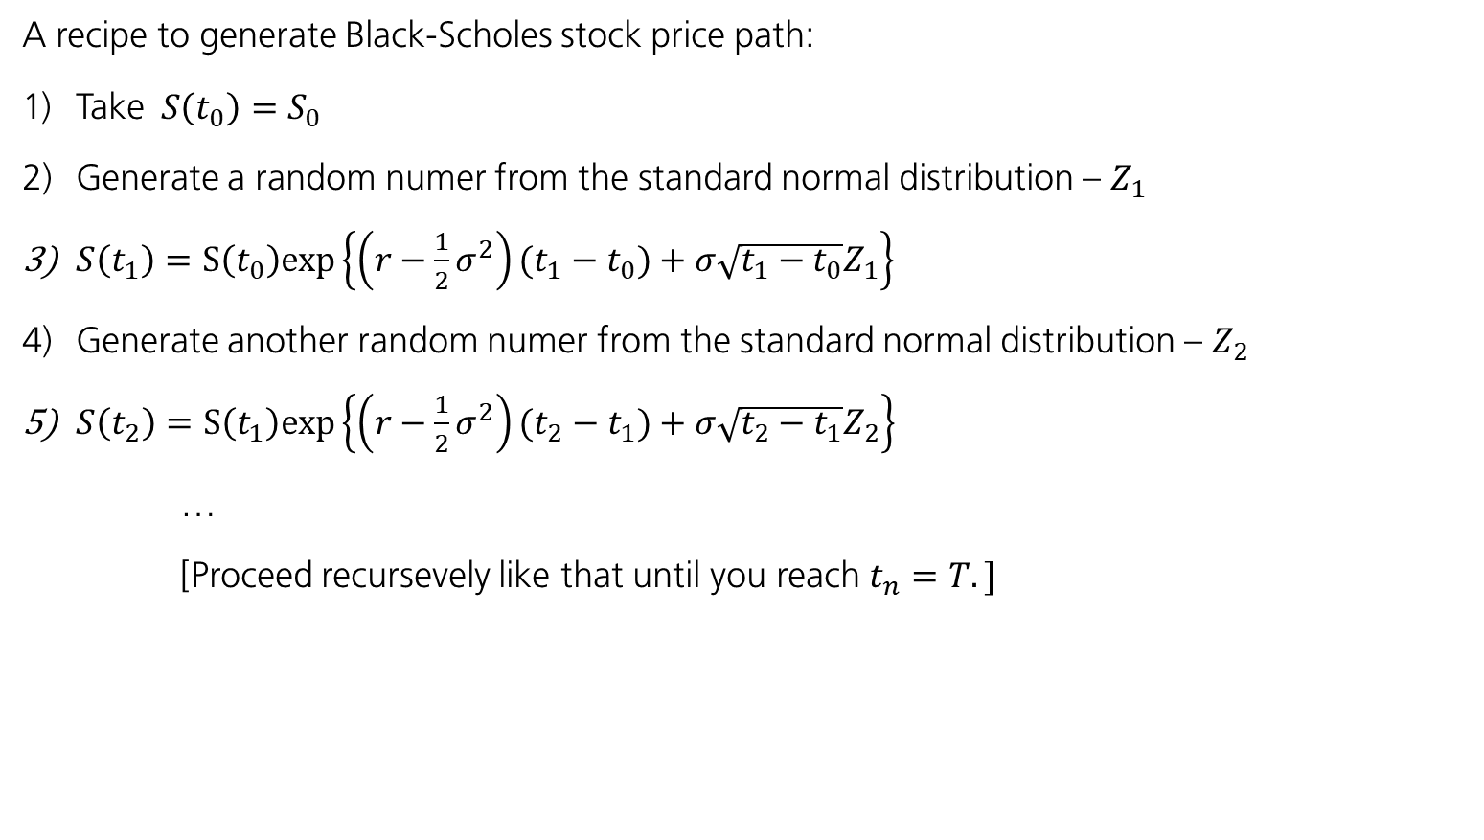
Monte Carlo Simulations
Stochastic process path generation example cnt’d
A recipe to generate Black-Scholes stock price path:
Take$S\left(t_{0}\right)=S_{0}$
Generate a random numer from the standard normal distribution – $Z_{1}$
$S\left(t_{1}\right)=S\left(t_{0}\right)exp\left\{\left(r−\frac{1}{2}σ^{2}\right)(t_{1}−t_{0})+σ\sqrt{t_{1}−t_{0}}Z_{1}\right\}$
Generate another random numer from the standard normal distribution – $Z_{2}$
$S\left(t_{2}\right)=S\left(t_{1}\right)exp\left\{\left(r−\frac{1}{2}σ^{2}\right)(t_{2}−t_{1})+σ\sqrt{t_{2}−t_{1}}Z_{2}\right\}$
…
[Proceed recursevely like that until you reach $t_{n}=T.]$

Slide 20
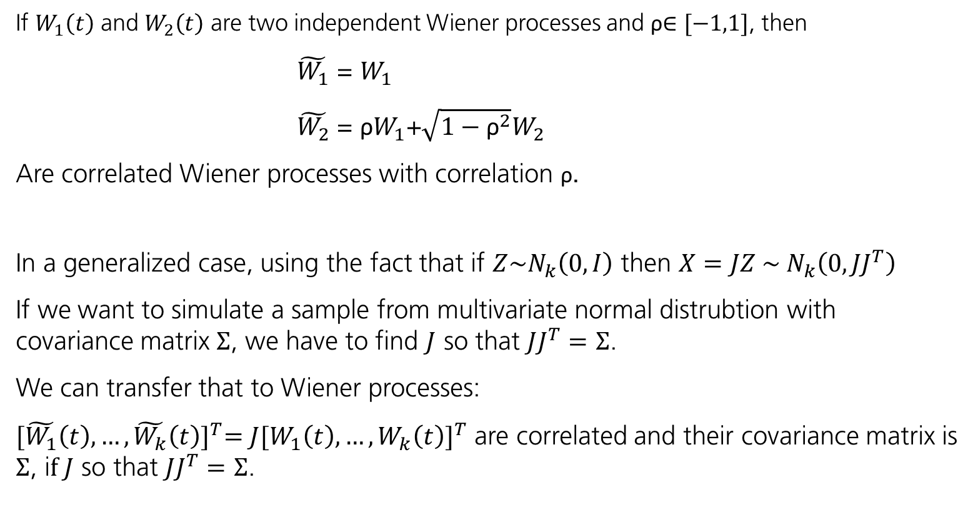
Modelling Counterparty Credit Risk
Simulation of correlated processes
If $W_{1}\left(t\right)$ and $W_{2}\left(t\right)$ are two independent Wiener processes and ρ$∈[−1,1]$, then
$\tilde{W_{1}}$ = $W_{1}$
$\tilde{W_{2}}$ = ${\text{ρ}W}_{1}$+$\sqrt{1−{\text{ρ}}^{2}}W_{2}$
Are correlated Wiener processes with correlation ρ.
In a generalized case, using the fact that if $Z\sim N_{k}\left(0,I\right)$ then $X=JZ \sim { N}_{k}\left(0,JJ^{T}\right)$
If we want to simulate a sample from multivariate normal distrubtion with covariance matrix $Σ$, we have to find $J$ so that $JJ^{T}=$ $Σ$.
We can transfer that to Wiener processes:
${[\tilde{W_{1}}\left(t\right),…,\tilde{W_{k}}\left(t\right)]}^{T}={J[W_{1}\left(t\right),…,W_{k}\left(t\right)]}^{T}$ are correlated and their covariance matrix is $Σ$, i$f J$ so that $JJ^{T}=$ $Σ$.

Slide 21
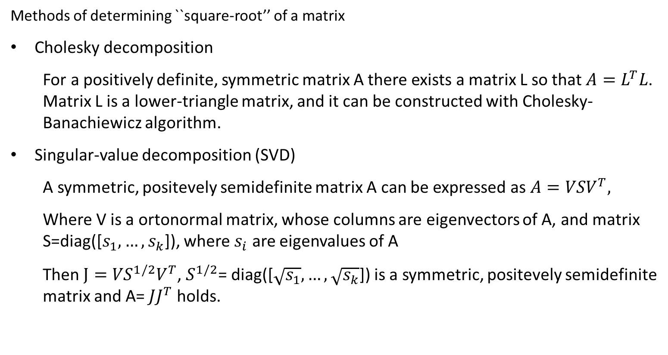
Modelling Counterparty Credit Risk
Simulation of correlated processes
Methods of determining ``square-root’’ of a matrix
Cholesky decomposition
For a positively definite, symmetric matrix A there exists a matrix L so that $A=L^{T}L$. Matrix L is a lower-triangle matrix, and it can be constructed with Cholesky-Banachiewicz algorithm.
Singular-value decomposition (SVD)
A symmetric, positevely semidefinite matrix A can be expressed as $A={VSV}^{T},$
Where V is a ortonormal matrix, whose columns are eigenvectors of A, and matrix S=diag([$s_{1},…, s_{k}$]), where $s_{i}$ are eigenvalues of A
Then $J={VS}^{1/2}V^{T}$, $S^{1/2}$= diag([$\sqrt{s_{1}},…,\sqrt{s_{k}}$]) is a symmetric, positevely semidefinite matrix and A= $JJ^{T}$ holds.

Slide 22
Section 3
Modelling Counterparty Credit Risk

Slide 23
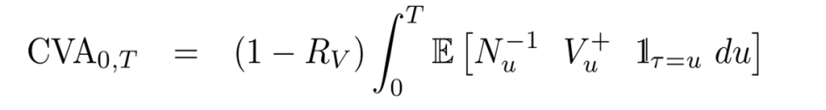
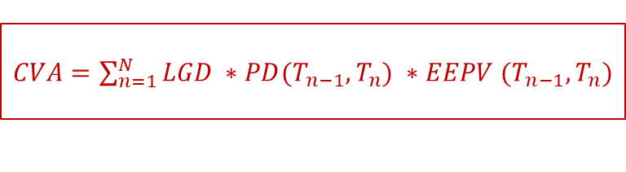
Modelling Counterparty Credit Risk
Expected Loss in the context of derivatives
We can simulate the evolution of the portfolio value over time
The equivalent of Expected Loss in derivatives world is called CVA (Credit Valuation Adjustments):
LGD
EAD part
PD part
Present Value of EPE
$CVA=\sum_{n=1}^{N}{LGD ∗PD(T_{n−1},T_{n})} ∗EEPV$ $(T_{n−1},T_{n})$
approx.

Slide 24
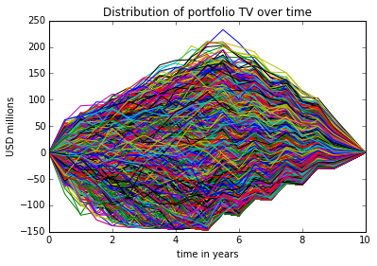
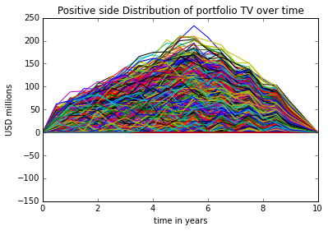
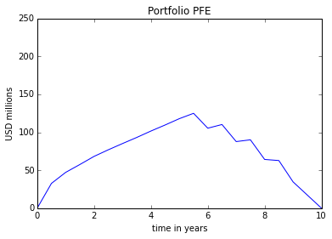
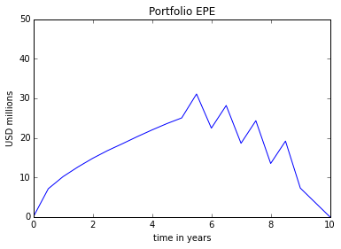
Modelling Counterparty Credit Risk
Portfolio Simulation
Portfolio of Derivatives
UBS
Counterparty

Slide 25
Modelling Counterparty Credit Risk
General CCR Modelling Recipe
Goal | Obtain risk profiles (EPE, PFE) for a given portfolio in order to compute CVA, RWA and regulatory capital.
Recipe | Choose a suitable risk factor model Calibrate the model – Bootstrapping, Minimum Squared Error, Closed Form Pricing Generate simulated paths, ie, simulate a variable of interest, eg.: short rate, stock price, spot FX; Price the portfolio - Backward Induction / AMC Compute profiles Compute measures like CVA, FVA, RWA, Regulatory Capital

Slide 26
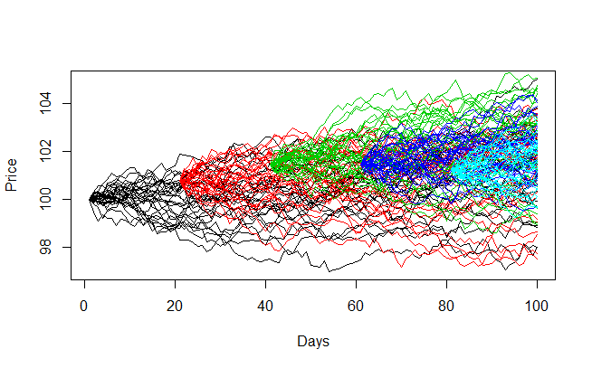
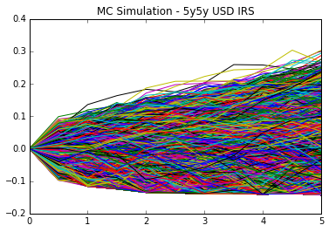
Modelling Counterparty Credit Risk
Challenges
The task of the computation of the exposure profiles for a derivative portfolio seems analogous to Value-at-Risk calculation but can be far more complicated due to :
far longer time horizon (often 30Y and beyond)
the risk-mitigants involved (netting, collateral, break clauses)
250 counterparties
40 transactions on average
100 simulation steps
10,000 scenarios
10 bln revaluations!
Efficiency of computation
is very important
Nested Monte Carlo

Slide 27
Section 5
Backward Induction and American Monte-Carlo Methods

Slide 28


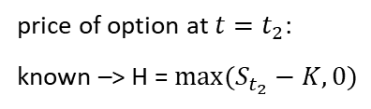




















Backward Induction and American Monte-Carlo Methods
Backward induction – binomial tree
Example: stock price evolution – 2-step binomial tree
$$p$$
$$S_{0}u^{2}$$
$$p$$
$$S_{0}u$$
$$1−p$$
$$S_{0}$$
$$1−p$$
$$p$$
$$S_{0}ud$$
$$S_{0}d$$
$$1−p$$
$$S_{0}d^{2}$$
$$t=t_{0}=0$$
$$t=t_{1}$$
$$t=t_{2}$$
European option pricing (call with expiry $t_{2}$, strike K)
option price at $t=0$
price of option at $t=t_{1}$:
$$V_{t}=E\left(e^{−r∆t}H\left(t_{2}\right) | F_{t_{1}}\right)$$
price of option at $t=t_{2}$:
known –> H = $max⁡(S_{t_{2}}−K,0)$
$$p$$
$${V_{t_{2}}}_{}^{uu}=max⁡(S_{0}u^{2}−K,0)$$
$$p$$
${{V_{t_{1}}}_{}^{u}=e}^{−r∆t}[{pH}_{uu}+(1−p)H_{ud}$]
${V_{0}=e}^{−r∆t}[p{V_{t}}_{}^{u}+(1−p){V_{t}}_{}^{d}$]
$$1−p$$
$${V_{t_{2}}}_{}^{ud}=max⁡(S_{0}ud−K,0)$$
$$p$$
$$1−p$$
${{V_{t_{1}}}_{}^{d}=e}^{−r∆t}[{pH}_{ud}+(1−p)H_{dd}$]
$$1−p$$
$${V_{t_{2}}}_{}^{dd}=max⁡(S_{0}d^{2}−K,0)$$
$$t=t_{0}=0$$
$$t=t_{1}$$
$$t=t_{2}$$

Slide 29





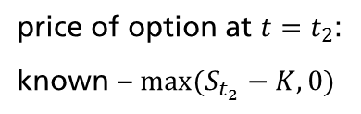



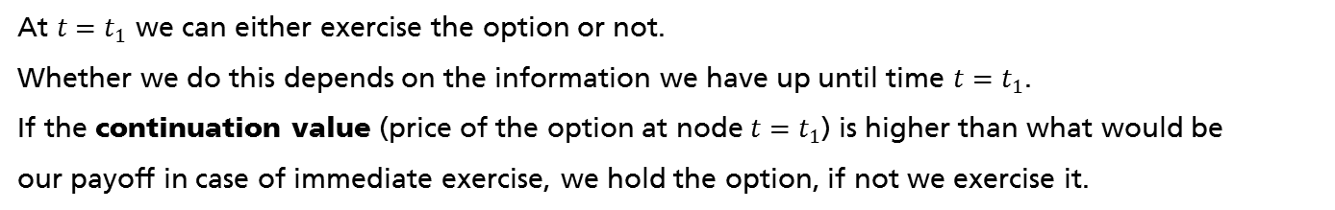




Backward Induction and American Monte-Carlo Methods
Backward induction – binomial tree cnt’d
American option is an option that can be exercised at any time between the trade start
and its contractual expiry.
option price at $t=0$
price of option at $t=t_{1}$:
price of option at $t=t_{2}$:
known – $max⁡(S_{t_{2}}−K,0)$
$$p$$
$${ H}_{uu}=max⁡(S_{0}u^{2}−K,0)$$
$$p$$
${V_{}^{u}=max⁡(e}^{−r∆t}[{pH}_{uu}+(1−p)H_{ud}$] $,max⁡(Su−K,0))$
$$V_{0}=…$$
$$1−p$$
$$H_{ud}=max⁡(S_{0}ud−K,0)$$
$$p$$
$$1−p$$
${V_{}^{d}=max⁡(e}^{−r∆t}[{pH}_{ud}+(1−p)H_{dd}$] $,max⁡(Sd−K,0))$
$$1−p$$
$$H_{dd}=max⁡(S_{0}d^{2}−K,0)$$
$$t=t_{0}=0$$
$$t=t_{1}$$
$$t=t_{2}$$
At $t=t_{1}$ we can either exercise the option or not.
Whether we do this depends on the information we have up until time $t=t_{1}$.
If the continuation value (price of the option at node $t=t_{1}$) is higher than what would be
our payoff in case of immediate exercise, we hold the option, if not we exercise it.

Slide 30

Backward Induction and American Monte-Carlo Methods
American Monte Carlo
$V_{n}$ = $h_{n}$ payoff at expiry
$V_{i}$= max{$h_{i}$, ${V_{i}}^{P}$} i < n
$h_{i}−payoff if we exercise at t_{i}$
How to compute the continuation value${{ V}_{i}}^{P}$?
Polynomial linear regression
$V_{i}≈P(t_{i}, t_{i+1})\left(ψ\left(O_{i}\right)\right)$, where $:$
$ψ$ is a polynomial function
$O_{i}$ are what we call the set of observables

Slide 31
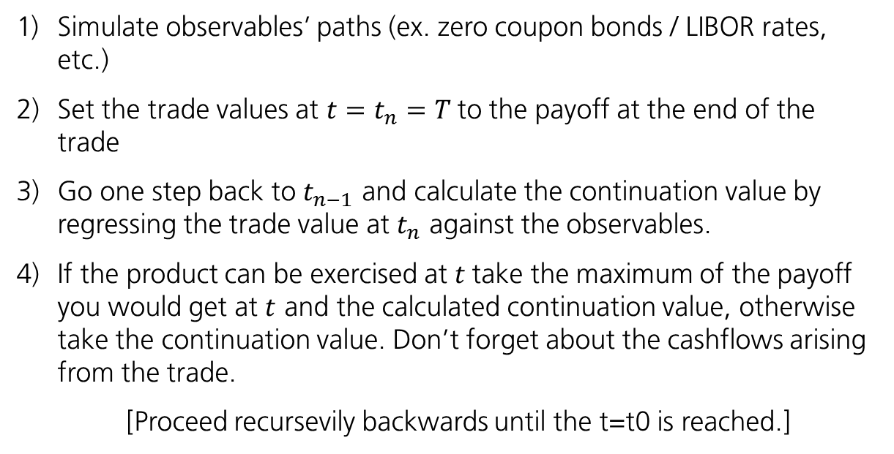
Backward Induction and American Monte- Carlo Methods
American Monte Carlo – step-by-step
Simulate observables’ paths (ex. zero coupon bonds / LIBOR rates, etc.)
Set the trade values at $t=t_{n}=T$to the payoff at the end of the trade
Go one step back to $t_{n−1}$ and calculate the continuation value by regressing the trade value at $t_{n}$ against the observables.
If the product can be exercised at $t$take the maximum of the payoff you would get at $t$ and the calculated continuation value, otherwise take the continuation value. Don’t forget about the cashflows arising from the trade.
[Proceed recursevily backwards until the t=t0 is reached.]
*Easy to follow example given at:
Longstaff, Schwartz; Valueing American Options in Simulations: A simple least-square approach;
(The review of financial studies, Vol14, No1, 2001.)

Slide 32
Walkthrough
Consider an American put option with a strike price of 1.10$ and final expiration date 3Y.
The riskless rate is 6%.

Slide 33
Walkthrough
Step 1: Simulate many realizations of the asset path from now to expiry

Slide 34
Walkthrough
Step 2: Compute the Payoff at Expiration (assuming no exercise beforehand)

Slide 35
Walkthrough
Step 3: Go to the next time step and discount cash flows.
t = 2
We consider only paths that are in the money at time 2

Slide 36
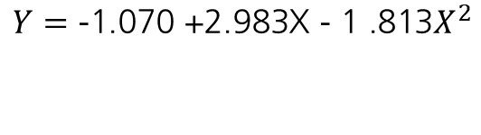
Walkthrough
Step 4: perform regression of y against x and compute the Continuation Value
t = 2
Path | X | Y | Continuation Value
1 | 1.08 | 0 | 0.0369
2 | - | - | -
3 | 1.07 | 0.066 | 0.0461
4 | 0.97 | 0.170 | 0.1176
5 | - | - | -
6 | 0.77 | 0.188 | 0.1520
7 | 0.84 | 0.085 | 0.1765
8 | - | - | -
$$Y=\text{−1.070 +2.983}\text{X}\text{ − 1 .813}X^{2}$$

Slide 37
Walkthrough
Step 5: compare the value of immediate exercise with the value from continuation.
t = 2

Slide 38
Walkthrough
Step 6: Update the cash flow Matrix based on the exercise decision

Slide 39
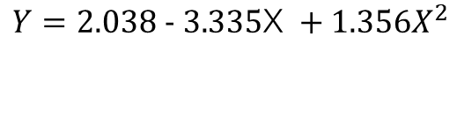
Walkthrough
Repeat steps 3-6
t = 1
$$Y=\text{2.038 − 3.335}\text{X} +1.356X^{2}$$
We consider only paths that are in the money at time 1

Slide 40
Walkthrough
Repeat steps 3-6
t = 1
Tisitsiklis-Van Roy algorithm uses continuation value in the regression,
Longstaff-Schwartz uses actual cash flows

Slide 41
Walkthrough
Update the cash flow Matrix based on the exercise decision
AMC Day 0 value is 0.1144

